Slide 1
Robotic Manipulation for Plant Interaction Using Reinforcement Learning

Slide 2
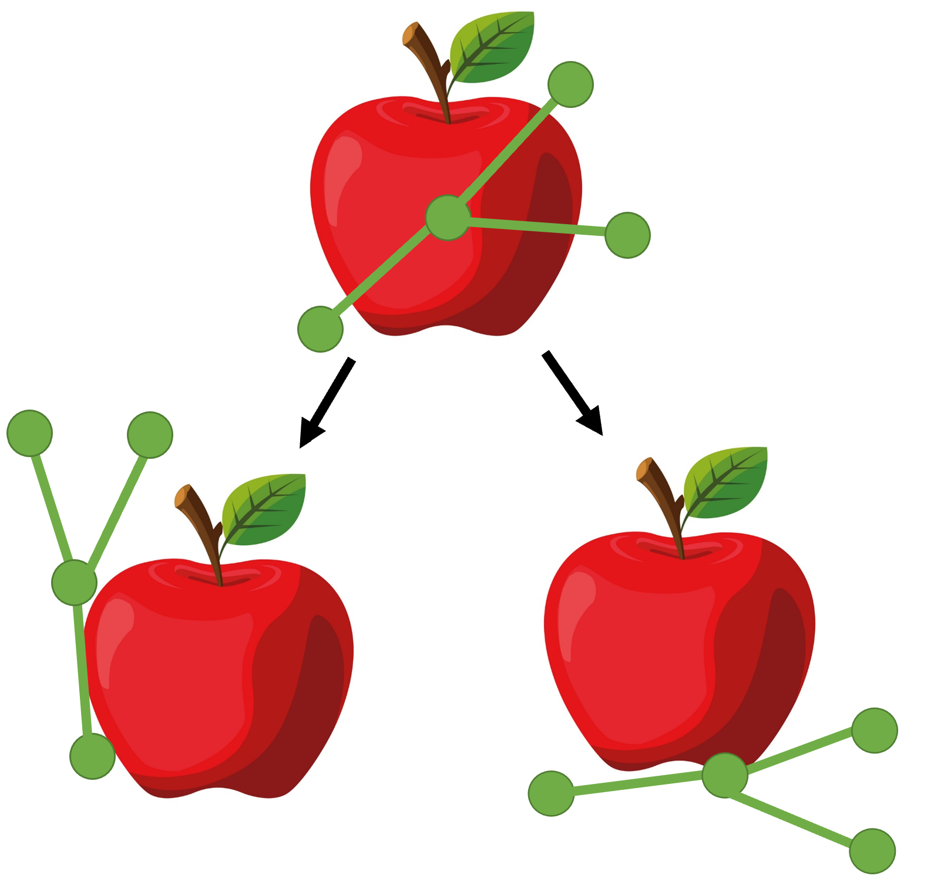
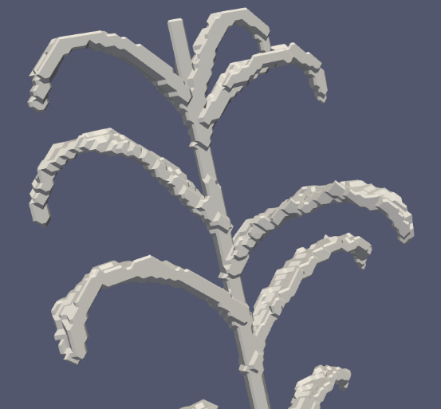
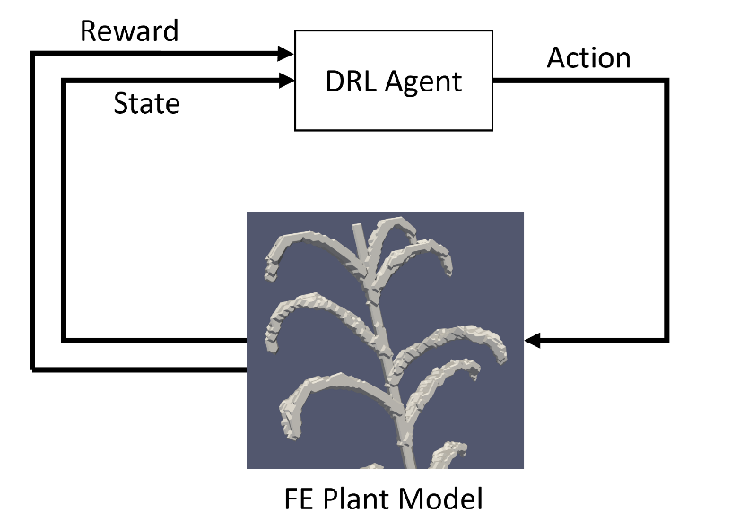
Project Stages
Low Fidelity Model Simplified 2D definition of plant Constraints on angles between links Evaluate possible manipulations and cleared states Evaluate number of steps required to reach no-occlusion state Tune DRL reward function and state space
FE Model Definition Material definition Fixed surfaces Boundary conditions Leaf definition as a rigid body Focus on stems
FE Model in Training Loop Application of force from robotic manipulator Tune DRL reward function and state space Evaluate energy required to manipulate plant Evaluate maximum stresses to manipulate plant

Slide 3
Link Model
Model the plant as a series of links
Define link parameters with Denavit-Hartenberg table
Build transformation matrices to determine poses
Train agent to…
Rotate correct joints to clear obstruction
Rotate correct joints to clear obstruction while minimizing:
Rotations/joint (measure of strain)
Manipulations per episode
3. Perform 1 and 2 above for a randomly initialized plant

Slide 4
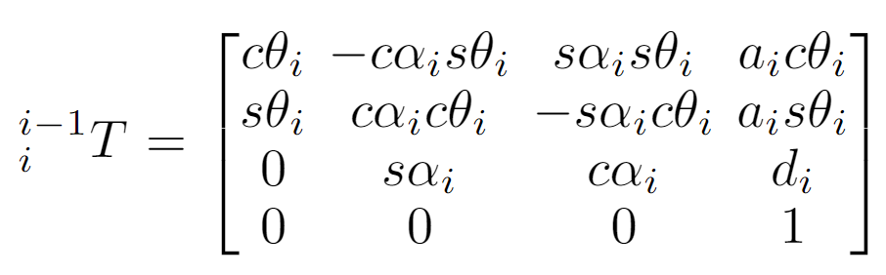
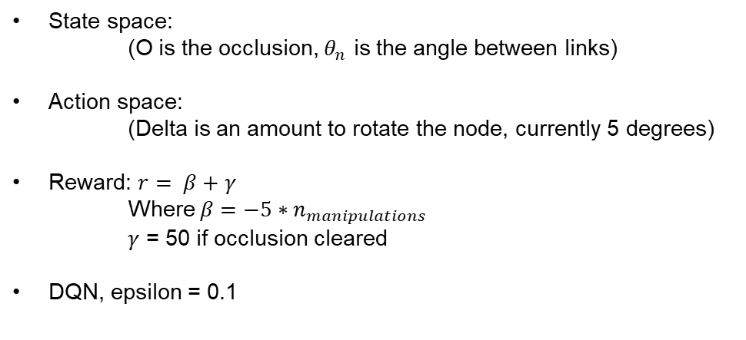
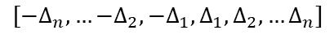
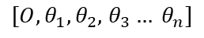
Link Model
State space:
(O is the occlusion, $θ_{n}$ is the angle between links)
Action space:
(Delta is an amount to rotate the node, currently 5 degrees)
Reward: $r= β+γ$
Where $β=−5∗n_{manipulations}$
$γ$ = 50 if occlusion cleared
DQN, epsilon = 0.1
$[O, θ_{1},θ_{2},$ $θ_{3}… θ_{n}]$
$$[−Δ_{n},…{−Δ}_{2},{−Δ}_{1},Δ_{1},Δ_{2},…Δ_{n}]$$
Notes:
Inscribed length/fruit radius

Slide 5
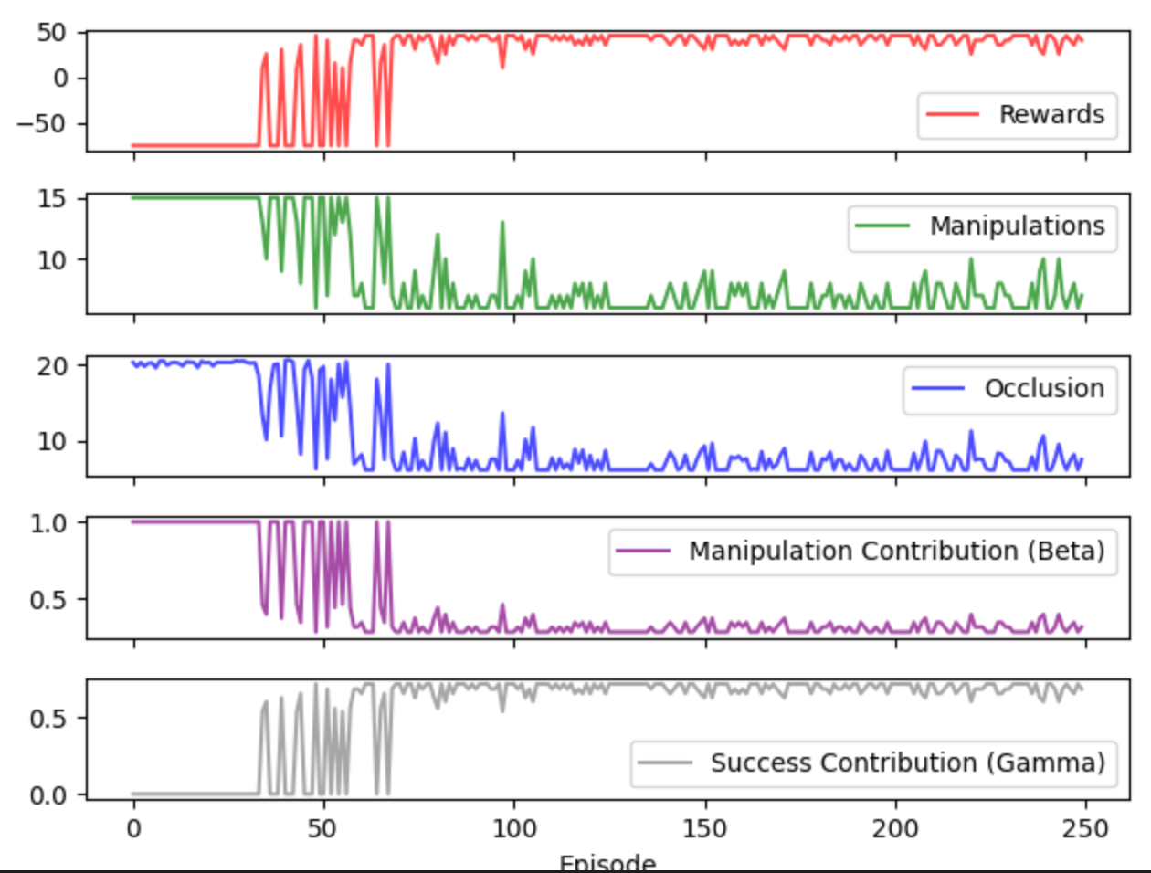

Slide 6
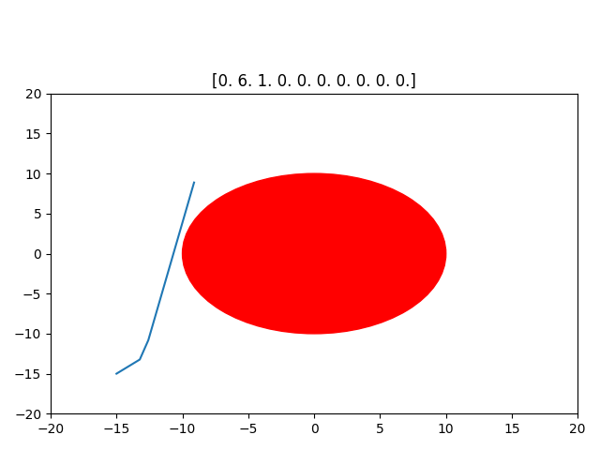



Link Model: Training to clear an obstruction

Slide 7
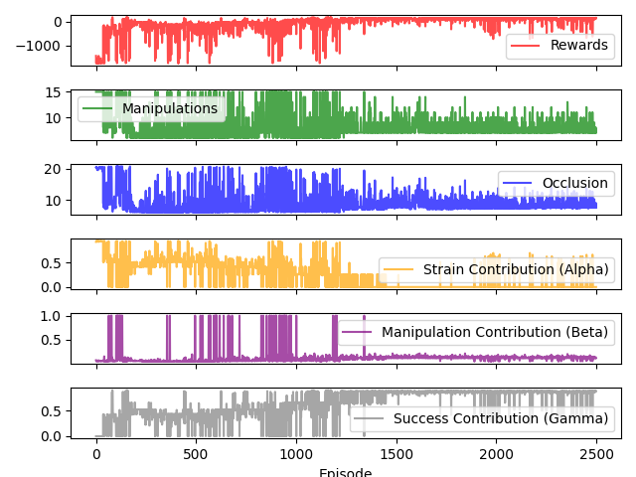
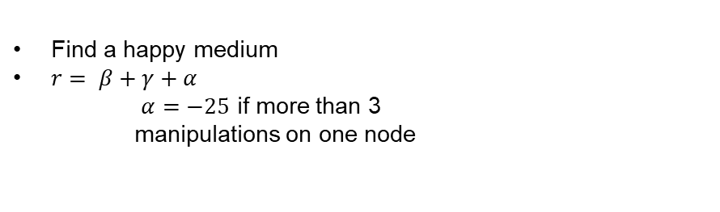
Try adding a strain component
Find a happy medium
$r= β+γ+α$
$α=−25$ if more than 3
manipulations on one node

Slide 8
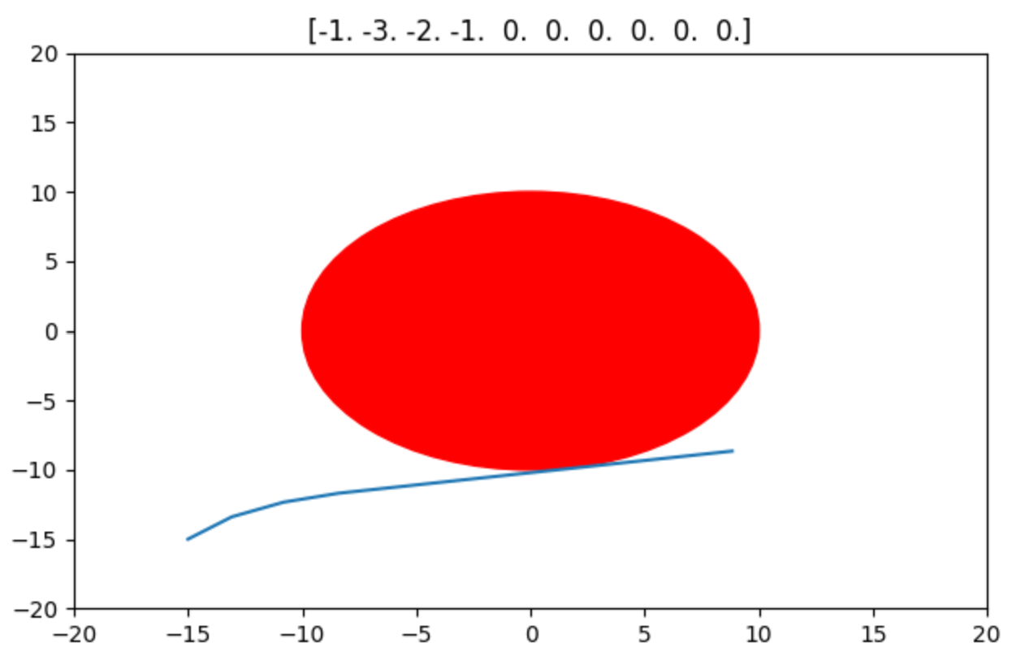

Try adding a strain component

Slide 9
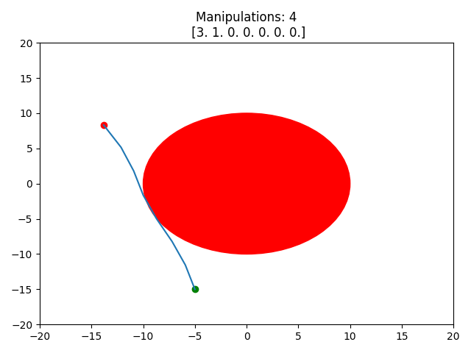
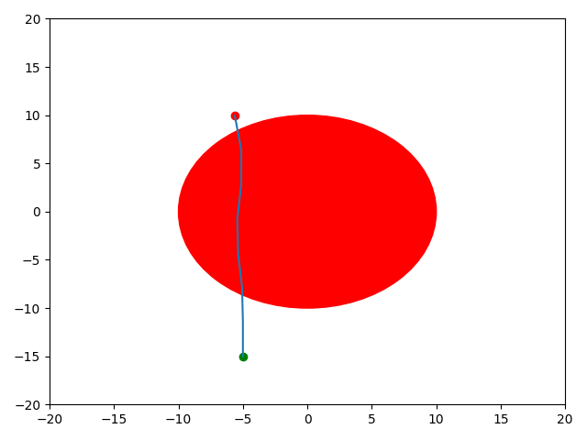
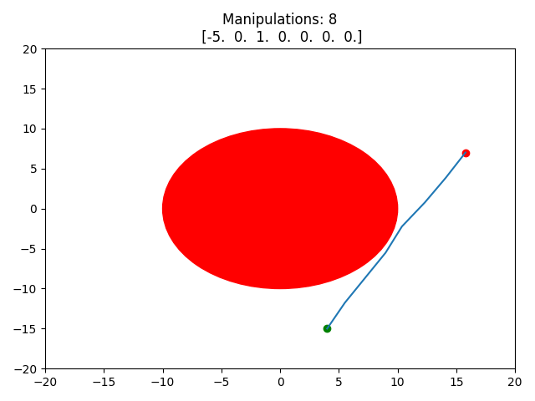
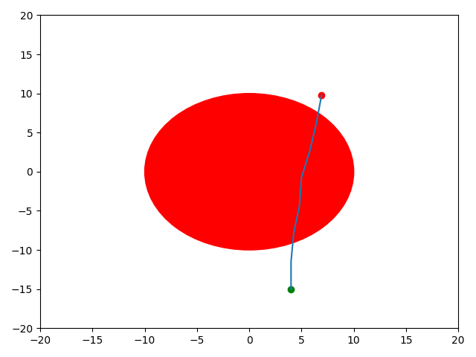
Random start/end?

Slide 10
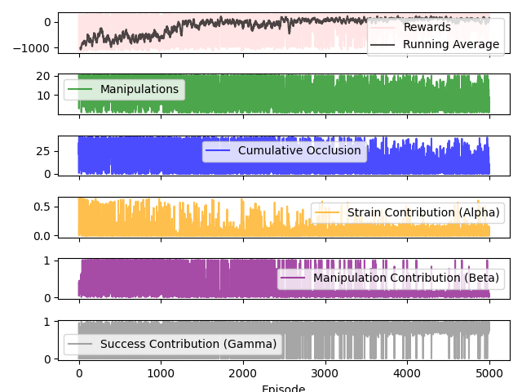
Random start/end?

Slide 11
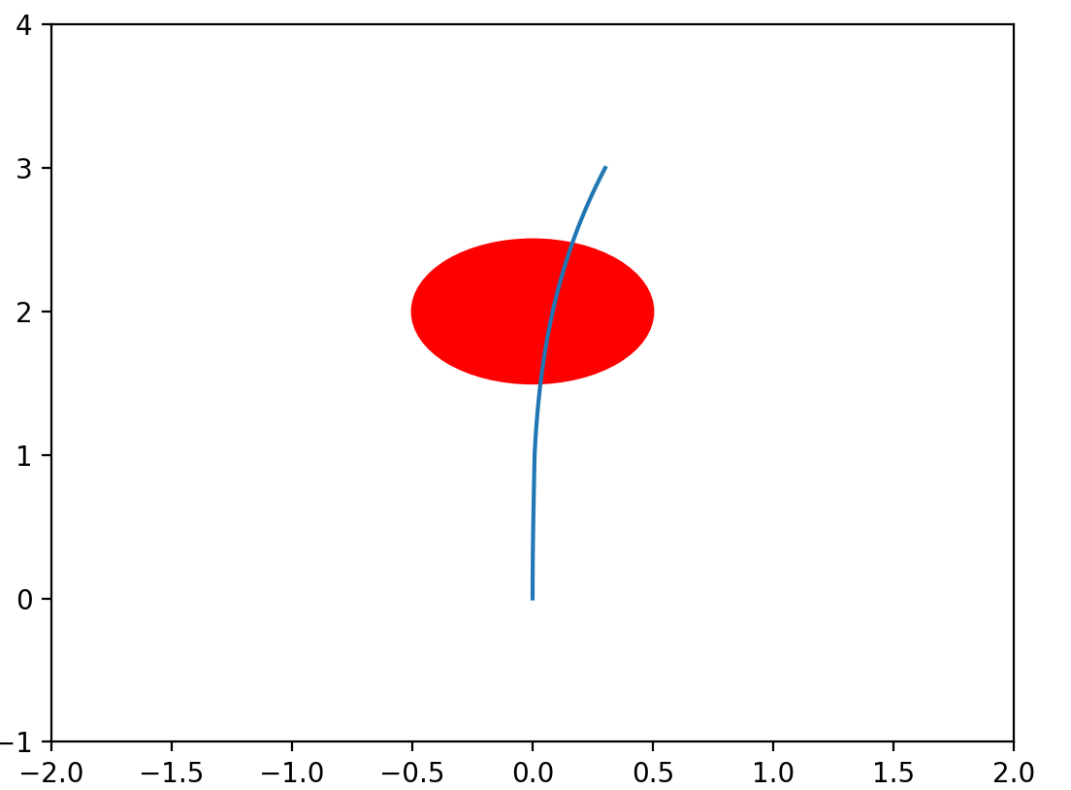
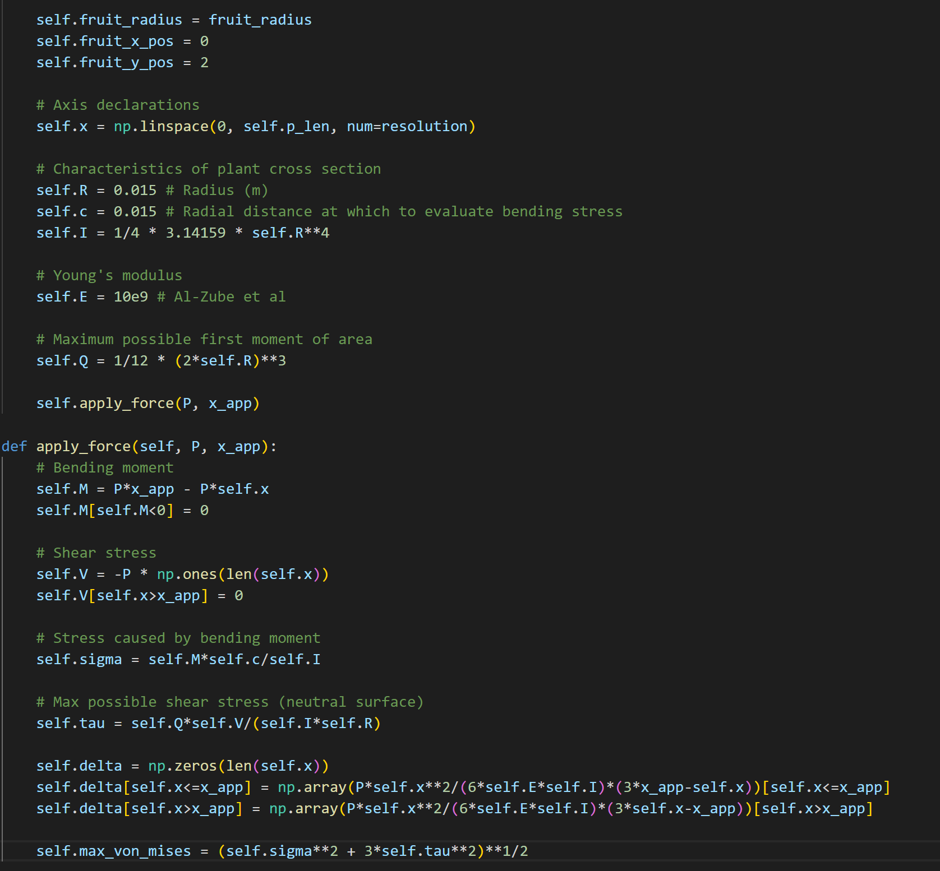
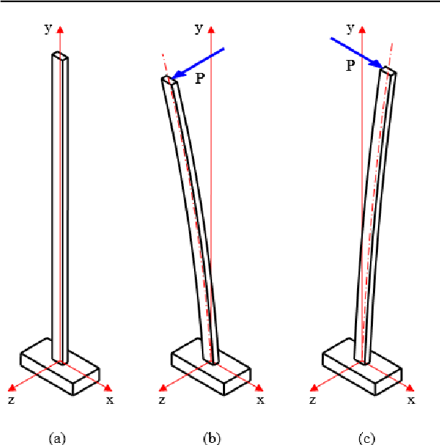
Cantilever Beam Model… next step

Slide 12
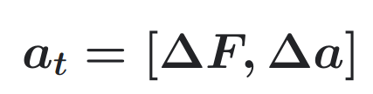
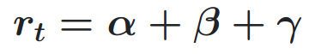
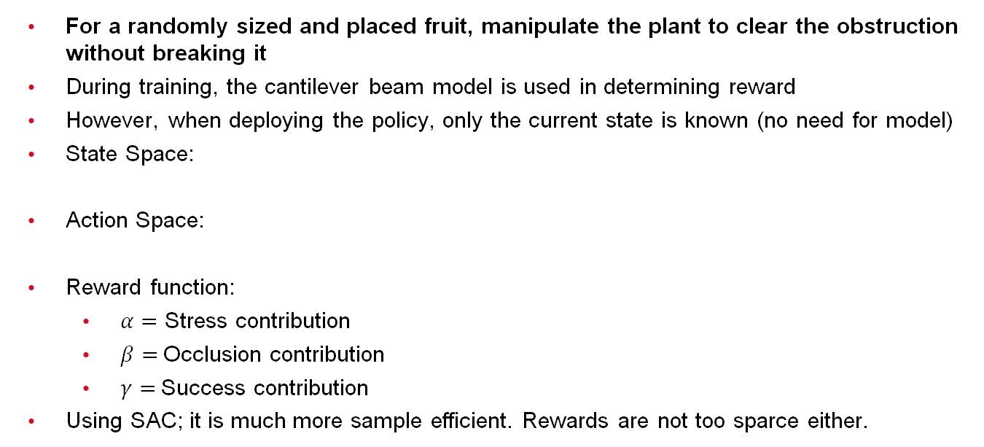
Using the Cantilever Beam Model
For a randomly sized and placed fruit, manipulate the plant to clear the obstruction without breaking it
During training, the cantilever beam model is used in determining reward
However, when deploying the policy, only the current state is known (no need for model)
State Space:
Action Space:
Reward function:
$α=$ Stress contribution
$β=$Occlusion contribution
$γ=$Success contribution
Using SAC; it is much more sample efficient. Rewards are not too sparce either.

Slide 13
Evaluation
Utilize the policy to manipulate the plant
For 100 trials:
For 50 steps:
Follow the action given by the policy given the current state
Again, state has no information given by the mechanical model
Evaluate and disposition trials:
If plant is successfully cleared and not broken -> Success
If plant is broken -> Break
If plant is neither cleared nor broken, continue applying force regardless:
If plant can be cleared without breaking -> False Stop
If plant cannot be cleared without breaking -> True Stop

Slide 14
Results (Model deployed for 100 episodes)

Slide 15
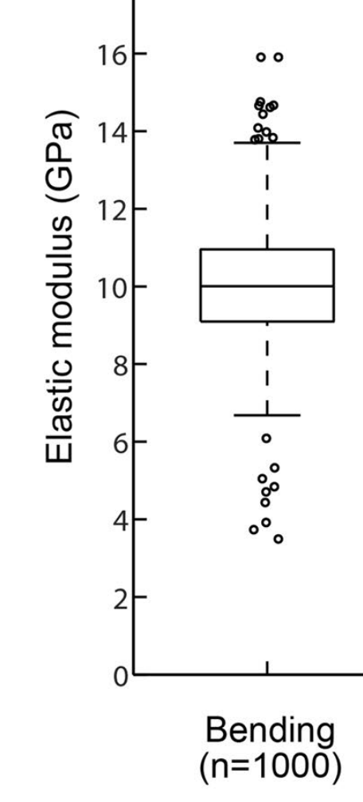
What if we randomize the elastic modulus?
Not all plants will have the same mechanical properties
For real deployment, the agent must develop a policy that works on a wide range of plants
Adjusting Young’s modulus is a good place to start.
Per Al-Zube et al:
9.98 ± 1.02 GPa
For each episode, sample from a Gaussian distribution with mean 10GPa, standard deviation 1 GPa

Slide 16
Results (100 episodes, randomized modulus)

Slide 17
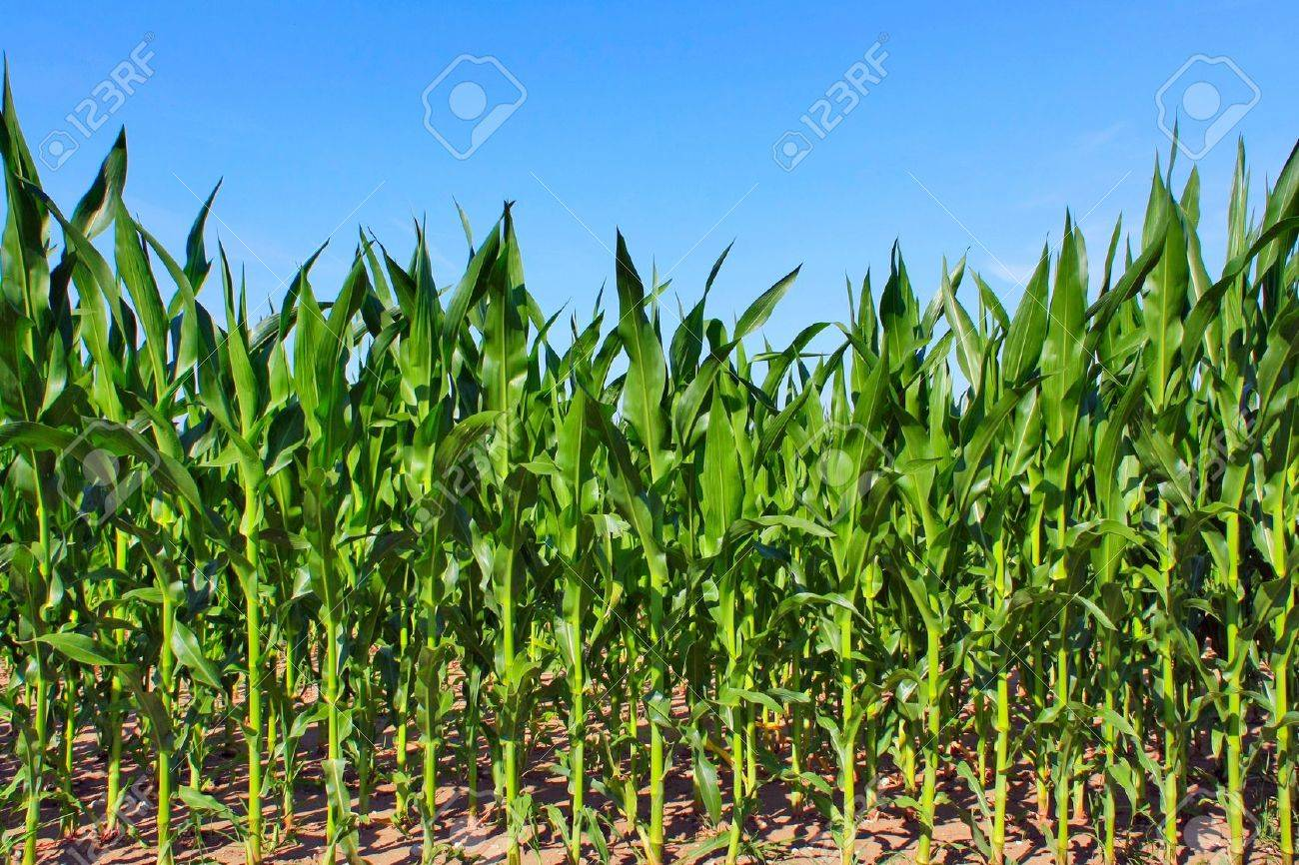
Proposed Architecture (Long Term)
RL Agent
Trained with impending break prediction, otherwise same as now
Utilize impending break prediction for bounding
State Estimator
Estimate from image
Plant/fruit pose
Impending break prediction
Action

Slide 18
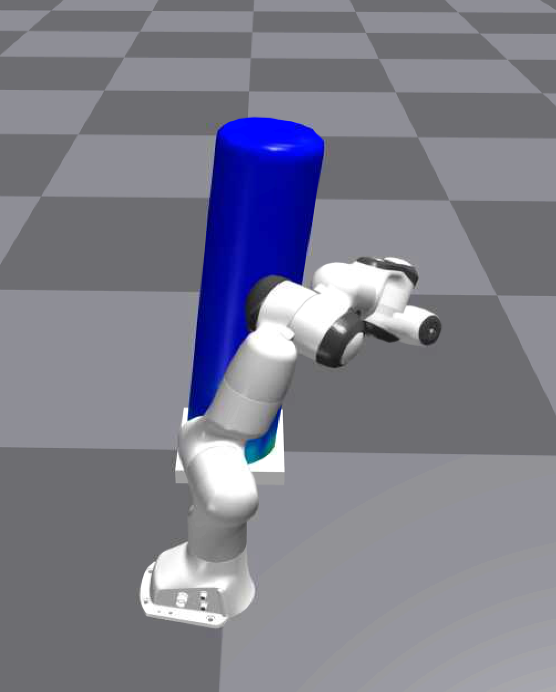
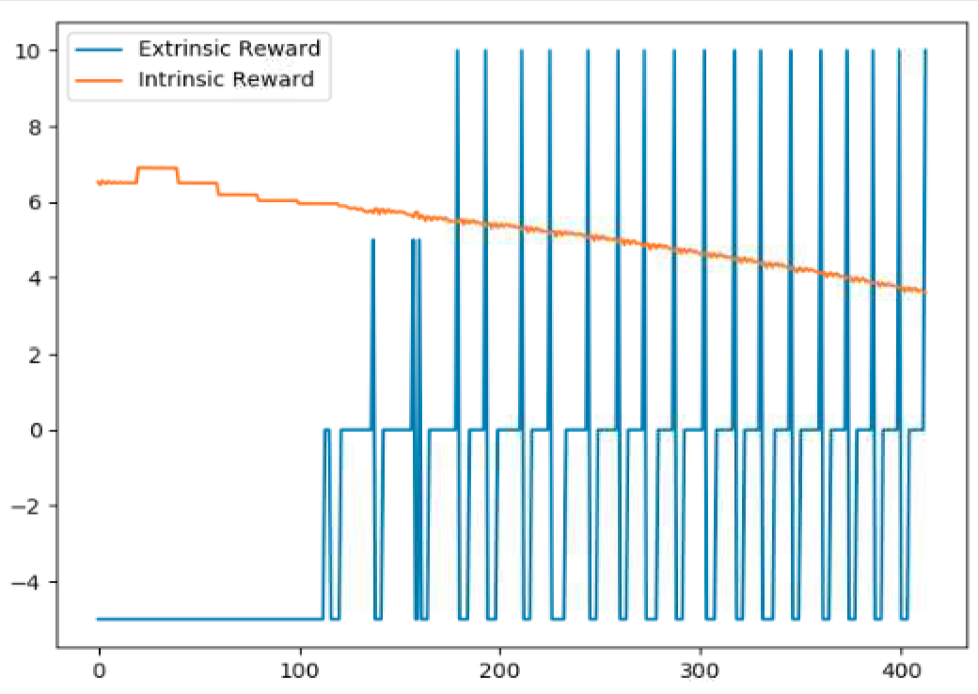
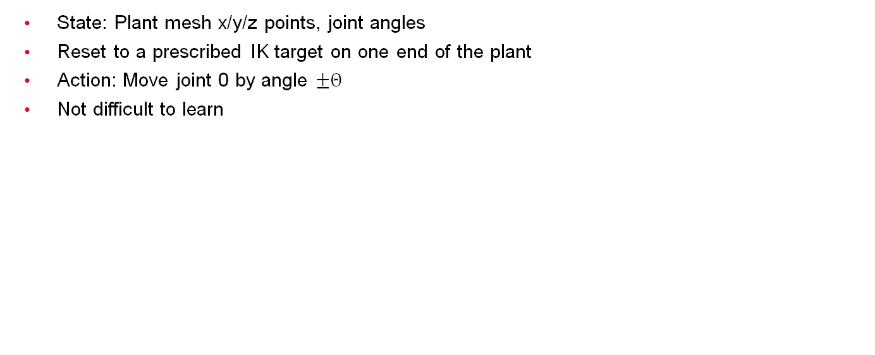
Follow Up
State: Plant mesh x/y/z points, joint angles
Reset to a prescribed IK target on one end of the plant
Action: Move joint 0 by angle $±Θ$
Not difficult to learn

Slide 19
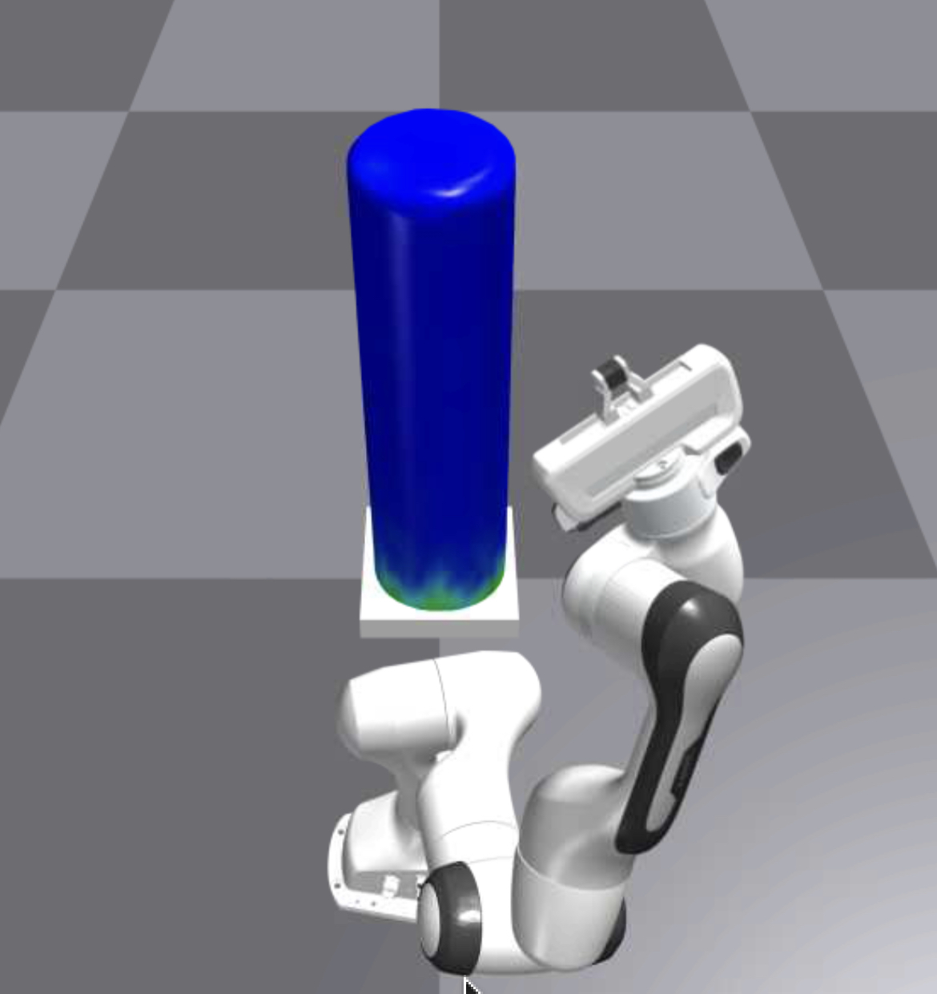
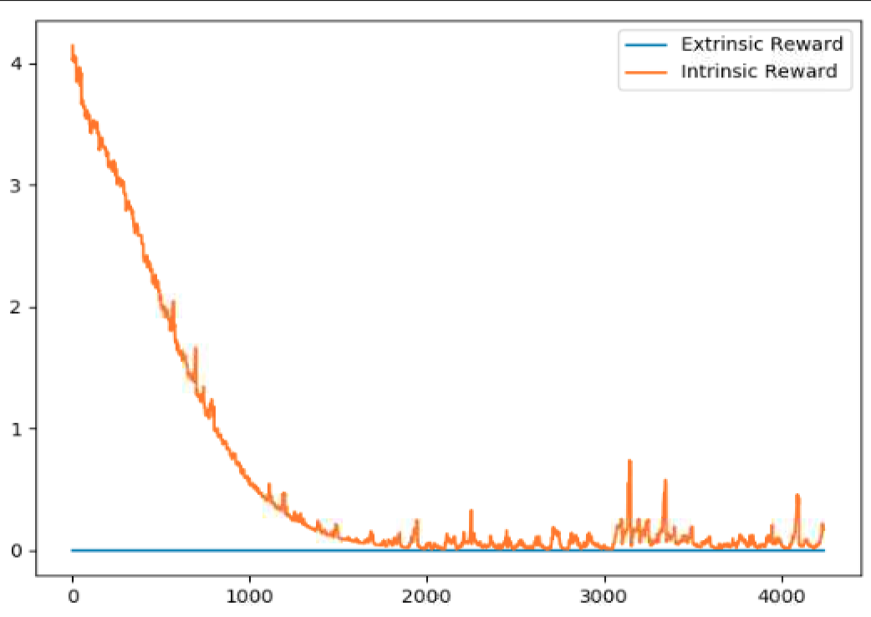
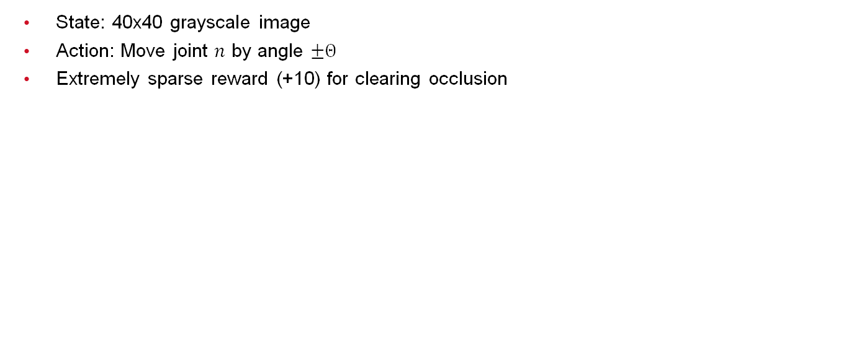
Pure Curiosity
State: 40x40 grayscale image
Action: Move joint $n$ by angle $±Θ$
Extremely sparse reward (+10) for clearing occlusion
Desired exploration of environment does occur, but very slowly
Huge computational expense of FE physics engine (60 steps/s)

Slide 20
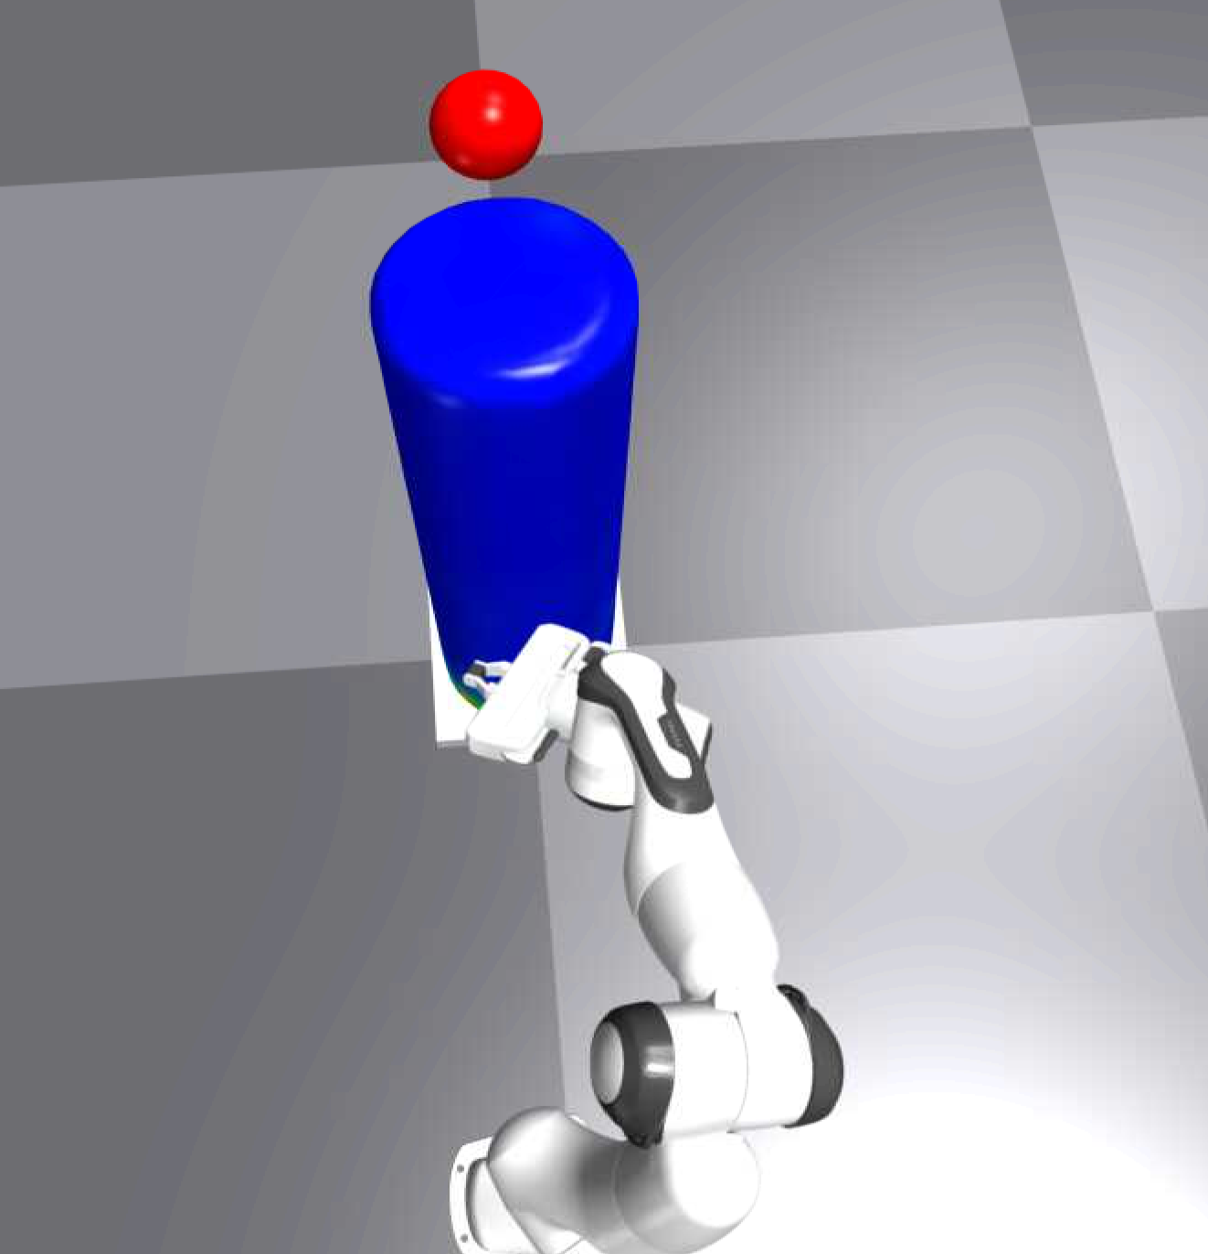
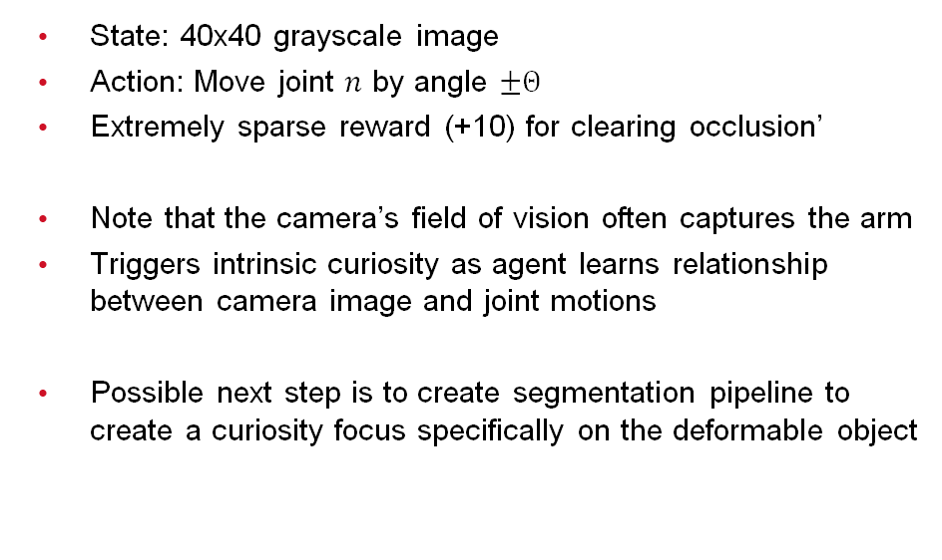
“Vanity”
State: 40x40 grayscale image
Action: Move joint $n$ by angle $±Θ$
Extremely sparse reward (+10) for clearing occlusion’
Note that the camera’s field of vision often captures the arm
Triggers intrinsic curiosity as agent learns relationship between camera image and joint motions
Possible next step is to create segmentation pipeline to create a curiosity focus specifically on the deformable object

Slide 21
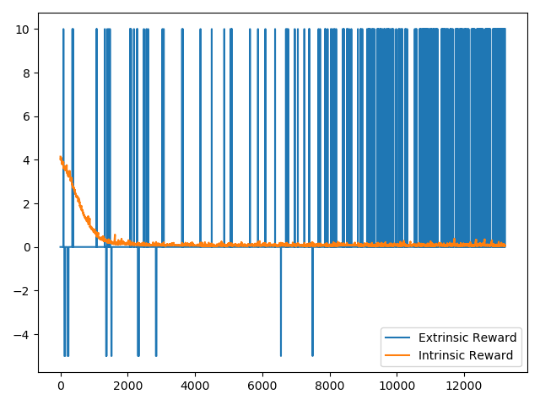
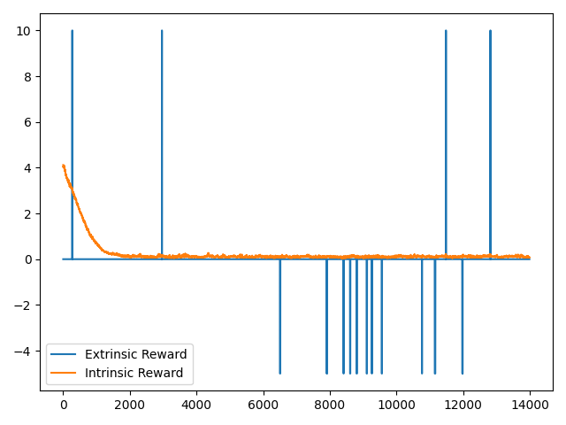
Guided vs Unguided Curiosity
Penalize reaching too far away from the plant
No penalty for exploration far away from plant

